Slide 1
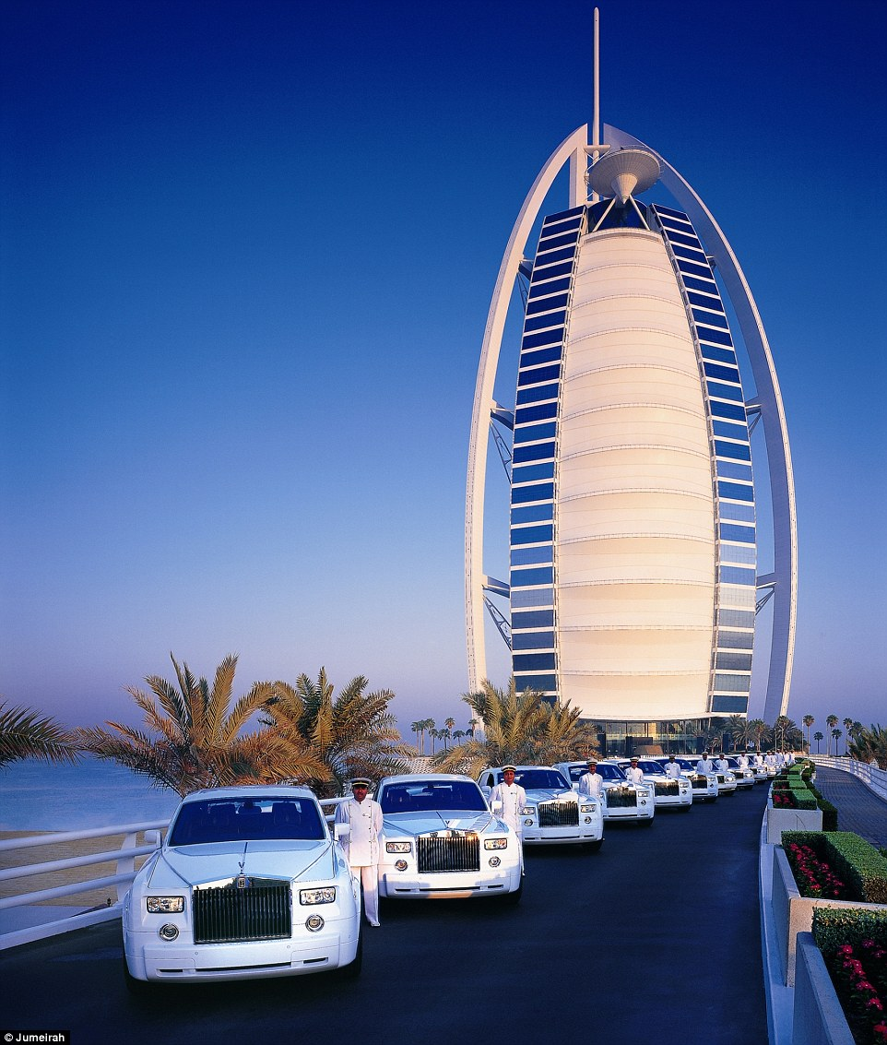
Restaurant management system
Great Burj Al Arab
7star Restaurant

Slide 2


TEAM
KAMALESH V
NARESH G
JAGADISH V

Slide 3

ABOUT
MINI PROJECT OF RESTAURANT MANAGEMENT
It offers more luxury than what a 5 star hotel does at a much higher price
The comfort and amenities provided on the silver platter are world-class
Every customer’s experience is personalized and the interests, likes & dislikes are taken care of
The rooms are spacious, but there is also a wide range of room types
The views from the rooms are exceptionally overwhelming
From a pool to a butler, everything is private

Slide 4
DATABASE CREATED IN PYMONGO

Slide 5

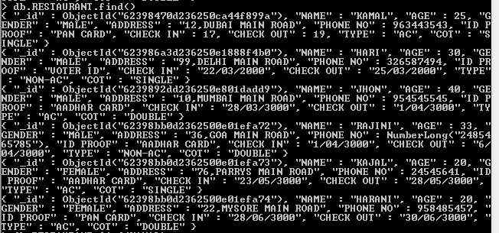
Inserting records

Slide 6
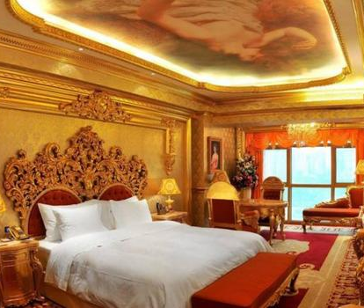

Showing record kamal

Slide 7

Index gender

Slide 8
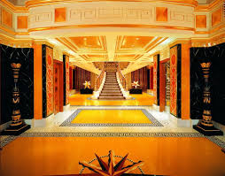
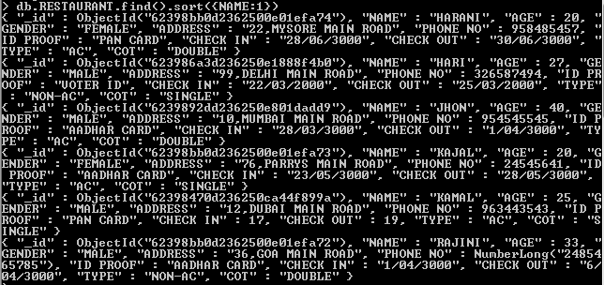
Record in ascending order

Slide 9

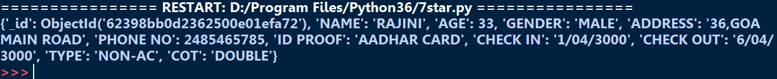
Showing record name start with r

Slide 10

Slide Title
MAXIMUM AGE IN COLLECTION

Slide 11

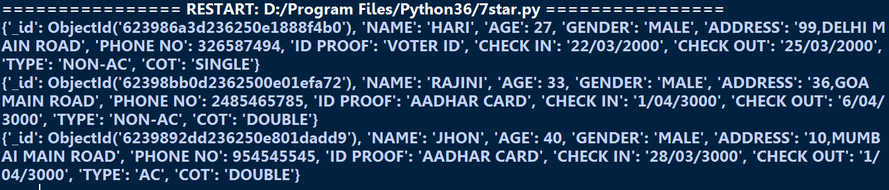
SHOWING RECORD AGE IS GREATER THEN 25

Slide 12
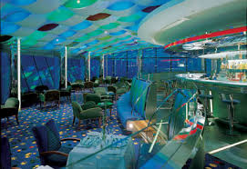
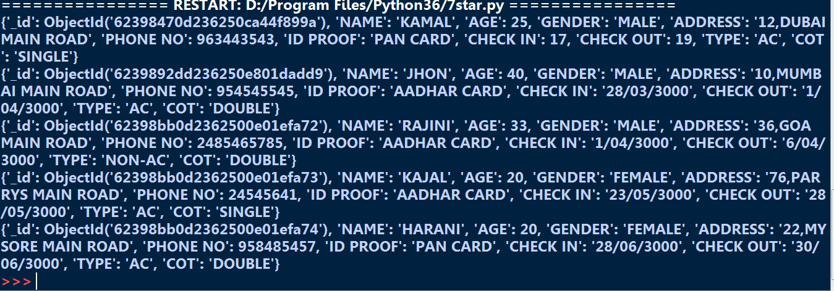
SHOWING ALL RECORD EXCEPT HARI

Slide 13

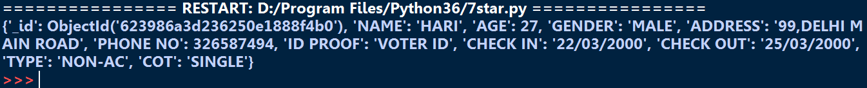
RECORD NAME HARI AND AGE 27

Slide 14
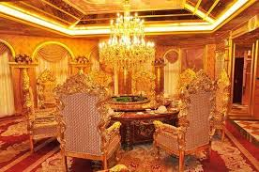
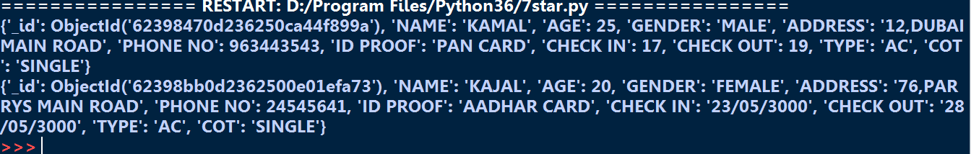
SHOWING ALL RECORD NAME START WITH ‘KA’

Slide 15
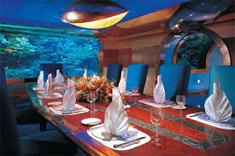
FINDING THE SUM OF AGE
11

Slide 16
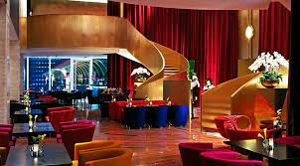
DELETING THE RECORD JHON
12

Slide 17

UPDATEING AGE FROM 25 TO 35
13

Slide 18
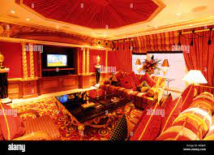
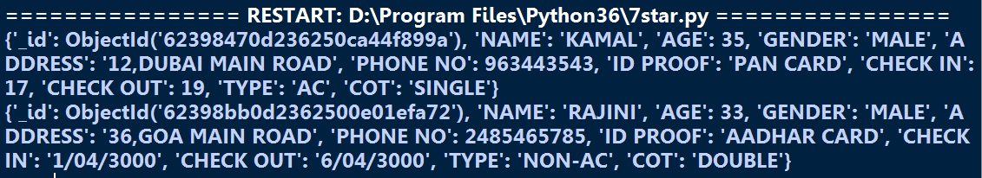
SHOWING RECORD NAME IS KAMAL OR RAJINI
14

Slide 19
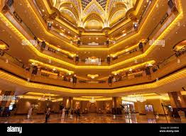
COUNT THE NUMBER OF RECORDS
15

Slide 20
THANK YOU

